Slide 1
Control Structures - I
Dr. Zahid Halim

Slide 2
Control Structures
Sequential execution
  Statements executed one after the other in the order written
Transfer of control
  When the next statement executed is not the next one in sequence
Bohm and Jacopini: all programs written in terms of 3 control structures
  Sequence structure
    Built into C++. Programs executed sequentially by default.
  Selection structures
    C++ has three types - if, if/else, and switch
  Repetition structures
    C++ has three types - while, do/while, and for

Slide 3
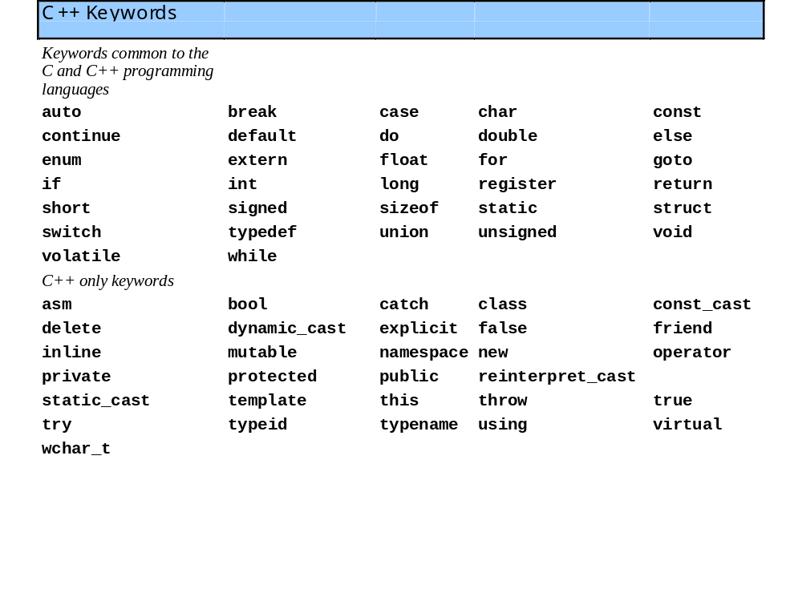
Control Structures
C++ keywords
  Cannot be used as identifiers or variable names.

Slide 4
Control Structures
Flowchart
  Graphical representation of an algorithm
  Drawn using certain special-purpose symbols connected by arrows called flowlines.
  Rectangle symbol (action symbol)
    Indicates any type of action.
  Oval symbol
    indicates beginning or end of a program, or a section of code (circles).
single-entry/single-exit control structures
  Connect exit point of one control structure to entry point of the next (control-structure stacking).
  Makes programs easy to build.

Slide 5
The if Selection Structure
Selection structure
  used to choose among alternative courses of action
  Pseudocode example:
      If student’s grade is greater than or equal to 60
      Print “Passed”
  If the condition is true
    print statement executed and program goes on to next statement
  If the condition is false
    print statement is ignored and the program goes onto the next statement
  Indenting makes programs easier to read
    C++ ignores whitespace characters

Slide 6
The if Selection Structure
Translation of pseudocode statement into C++:
      if ( grade >= 60 )
      cout << "Passed";
Diamond symbol (decision symbol)
  indicates decision is to be made
  Contains an expression that can be true or false.
    Test the condition, follow appropriate path
if structure is a single-entry/single-exit structure

Slide 7
The if Selection Structure
Flowchart of pseudocode statement
A decision can be made on any expression.
zero - false
nonzero - true
Example:
3 - 4 is true
true
grade >= 60
print “Passed”
false

Slide 8
The if/else Selection Structure
if
  Only performs an action if the condition is true
if/else
  A different action is performed when condition is true and when condition is false
Psuedocode
    if student’s grade is greater than or equal to 60
    print “Passed”
    else
    print “Failed”
C++ code
    if ( grade >= 60 )
    cout << "Passed";
    else
    cout << "Failed";

Slide 9
The if/else Selection Structure
Ternary conditional operator (?:)
  Takes three arguments (condition, value if true, value if false)
Our pseudocode could be written:
    cout << ( grade >= 60 ? “Passed” : “Failed” );
false
true
grade >= 60
print “Failed”
print “Passed”

Slide 10
The if/else Selection Structure
Nested if/else structures
  Test for multiple cases by placing if/else selection structures inside if/else selection structures.
    if student’s grade is greater than or equal to 90
    Print “A”
    else
    if student’s grade is greater than or equal to 80
    Print “B”
    else
    if student’s grade is greater than or equal to 70
    Print “C”
    else
    if student’s grade is greater than or equal to 60
    Print “D”
    else
    Print “F”
  Once a condition is met, the rest of the statements are skipped

Slide 11
The if/else Selection Structure
Compound statement:
  Set of statements within a pair of braces
  Example:
      if ( grade >= 60 )
      cout << "Passed.\n";
      else {
      cout << "Failed.\n";
      cout << "You must take this course again.\n";
      }
  Without the braces,
  cout << "You must take this course again.\n";
  would be automatically executed
Block
  Compound statements with declarations

Slide 12
The if/else Selection Structure
Syntax errors
  Errors caught by compiler
Logic errors
  Errors which have their effect at execution time
    Non-fatal logic errors
      program runs, but has incorrect output
    Fatal logic errors
      program exits prematurely

Slide 13
The while Repetition Structure
Repetition structure
  Programmer specifies an action to be repeated while some condition remains true
  Psuedocode
    while there are more items on my shopping list
    Purchase next item and cross it off my list
  while loop repeated until condition becomes false.
Example
      int product = 2;
      while ( product <= 1000 )
      product = 2 * product;

Slide 14
The while Repetition Structure
Flowchart of while loop
true
product <= 1000
product = 2 * product
false

Slide 15
Formulating Algorithms (Counter-Controlled Repetition)
Counter-controlled repetition
  Loop repeated until counter reaches a certain value.
Definite repetition
  Number of repetitions is known
Example
  A class of ten students took a quiz. The grades (integers in the range 0 to 100) for this quiz are available to you. Determine the class average on the quiz.

Slide 16
Formulating Algorithms (Counter-Controlled Repetition)
Pseudocode for example:
    Set total to zero
    Set grade counter to one
    While grade counter is less than or equal to ten
    Input the next grade
    Add the grade into the total
    Add one to the grade counter
    Set the class average to the total divided by ten
    Print the class average
Following is the C++ code for this example

Slide 17
1 // Fig. 2.7: fig02_07.cpp
2 // Class average program with counter-controlled repetition
3 #include <iostream>
4
5 using std::cout;
6 using std::cin;
7 using std::endl;
8
9 int main()
10 {
11 int total, // sum of grades
12 gradeCounter, // number of grades entered
13 grade, // one grade
14 average; // average of grades
15
16 // initialization phase
17 total = 0; // clear total
18 gradeCounter = 1; // prepare to loop
The counter gets incremented each time the loop executes. Eventually, the counter causes the loop to end.
19
20 // processing phase
21 while ( gradeCounter <= 10 ) { // loop 10 times
22 cout << "Enter grade: "; // prompt for input
23 cin >> grade; // input grade
24 total = total + grade; // add grade to total
25 gradeCounter = gradeCounter + 1; // increment counter
26 }
27
28 // termination phase
29 average = total / 10; // integer division
30 cout << "Class average is " << average << endl;
31
32 return 0; // indicate program ended successfully
33 }

Slide 18
Enter grade: 98
Enter grade: 76
Enter grade: 71
Enter grade: 87
Enter grade: 83
Enter grade: 90
Enter grade: 57
Enter grade: 79
Enter grade: 82
Enter grade: 94
Class average is 81

Slide 19
Control Structures - I
Dr. Zahid Halim

Slide 20
Formulating Algorithms with Top-Down, Stepwise Refinement (Sentinel-Controlled Repetition)
Suppose the problem becomes:
  Develop a class-averaging program that will process an arbitrary number of grades each time the program is run.
  Unknown number of students - how will the program know to end?
Sentinel value
  Indicates “end of data entry”
  Loop ends when sentinel inputted
  Sentinel value chosen so it cannot be confused with a regular input (such as -1 in this case)

Slide 21
Formulating Algorithms with Top-Down, Stepwise Refinement (Sentinel-Controlled Repetition)
Top-down, stepwise refinement
  begin with a pseudocode representation of the top:
      Determine the class average for the quiz
  Divide top into smaller tasks and list them in order:
      Initialize variables
      Input, sum and count the quiz grades
      Calculate and print the class average

Slide 22
Formulating Algorithms with Top-Down, Stepwise Refinement
Many programs can be divided into three phases:
  Initialization
    Initializes the program variables
  Processing
    Inputs data values and adjusts program variables accordingly
  Termination
    Calculates and prints the final results.
    Helps the breakup of programs for top-down refinement.
Refine the initialization phase from
      Initialize variables
        to
      Initialize total to zero
      Initialize counter to zero

Slide 23
Formulating Algorithms with Top-Down, Stepwise Refinement
Refine
    Input, sum and count the quiz grades
        to
    Input the first grade (possibly the sentinel)
    While the user has not as yet entered the sentinel
    Add this grade into the running total
    Add one to the grade counter
    Input the next grade (possibly the sentinel)
Refine
    Calculate and print the class average
        to
    If the counter is not equal to zero
    Set the average to the total divided by the counter
    Print the average
    Else
    Print “No grades were entered”

Slide 24
1 // Fig. 2.9: fig02_09.cpp
2 // Class average program with sentinel-controlled repetition.
3 #include <iostream>
4
5 using std::cout;
6 using std::cin;
7 using std::endl;
8 using std::ios;
9
10 #include <iomanip>
11
12 using std::setprecision;
13 using std::setiosflags;
14
15 int main()
Data type double used to represent decimal numbers.
16 {
17 int total, // sum of grades
18 gradeCounter, // number of grades entered
19 grade; // one grade
20 double average; // number with decimal point for average
21
22 // initialization phase
23 total = 0;
24 gradeCounter = 0;
25
26 // processing phase
27 cout << "Enter grade, -1 to end: ";
28 cin >> grade;
29
30 while ( grade != -1 ) {

Slide 25
31 total = total + grade;
32 gradeCounter = gradeCounter + 1;
33 cout << "Enter grade, -1 to end: ";
34 cin >> grade;
35 }
36
37 // termination phase
38 if ( gradeCounter != 0 ) {
39 average = static_cast< double >( total ) / gradeCounter;
40 cout << "Class average is " << setprecision( 2 )
41 << setiosflags( ios::fixed | ios::showpoint )
42 << average << endl;
43 }
setiosflags(ios::fixed | ios::showpoint) - stream manipulator
ios::fixed - output numbers with a fixed number of decimal points.
ios::showpoint - forces decimal point and trailing zeros, even if unnecessary: 66 printed as 66.00
| - separates multiple option.
44 else
static_cast<double>() - treats total as a double temporarily.
Required because dividing two integers truncates the remainder.
gradeCounter is an int, but it gets promoted to double.
45 cout << "No grades were entered" << endl;
46
47 return 0; // indicate program ended successfully
48 }
Enter grade, -1 to end: 75
Enter grade, -1 to end: 94
Enter grade, -1 to end: 97
Enter grade, -1 to end: 88
Enter grade, -1 to end: 70
Enter grade, -1 to end: 64
Enter grade, -1 to end: 83
Enter grade, -1 to end: 89
Enter grade, -1 to end: -1
Class average is 82.50
setprecision(2) - prints only two digits past decimal point.
Programs that use this must include <iomanip>

Slide 26
Nested control structures
Problem:
  A college has a list of test results (1 = pass, 2 = fail) for 10 students. Write a program that analyzes the results. If more than 8 students pass, print "Raise Tuition".
We can see that
  The program must process 10 test results. A counter-controlled loop will be used.
  Two counters can be used—one to count the number of students who passed the exam and one to count the number of students who failed the exam.
  Each test result is a number—either a 1 or a 2. If the number is not a 1, we assume that it is a 2.
Top level outline:
    Analyze exam results and decide if tuition should be raised

Slide 27
Nested control structures
First Refinement:
    Initialize variables
    Input the ten quiz grades and count passes and failures
    Print a summary of the exam results and decide if tuition should be raised
Refine
      Initialize variables
        to
      Initialize passes to zero
      Initialize failures to zero
      Initialize student counter to one

Slide 28
Nested control structures
Refine
    Input the ten quiz grades and count passes and failures
        to
    While student counter is less than or equal to ten
    Input the next exam result
    If the student passed
    Add one to passes
    Else
    Add one to failures
    Add one to student counter
Refine
    Print a summary of the exam results and decide if tuition should be raised
        to
    Print the number of passes
    Print the number of failures
    If more than eight students passed
    Print “Raise tuition”

Slide 29
1 // Fig. 2.11: fig02_11.cpp
2 // Analysis of examination results
3 #include <iostream>
4
5 using std::cout;
6 using std::cin;
7 using std::endl;
8
9 int main()
10 {
11 // initialize variables in declarations
12 int passes = 0, // number of passes
13 failures = 0, // number of failures
14 studentCounter = 1, // student counter
15 result; // one exam result
16
17 // process 10 students; counter-controlled loop
18 while ( studentCounter <= 10 ) {
19 cout << "Enter result (1=pass,2=fail): ";
20 cin >> result;
21
22 if ( result == 1 ) // if/else nested in while
23 passes = passes + 1;

Slide 30
24 else
25 failures = failures + 1;
26
27 studentCounter = studentCounter + 1;
28 }
29
30 // termination phase
31 cout << "Passed " << passes << endl;
32 cout << "Failed " << failures << endl;
33
34 if ( passes > 8 )
35 cout << "Raise tuition " << endl;
36
37 return 0; // successful termination
38 }
Enter result (1=pass,2=fail): 1
Enter result (1=pass,2=fail): 1
Enter result (1=pass,2=fail): 1
Enter result (1=pass,2=fail): 1
Enter result (1=pass,2=fail): 2
Enter result (1=pass,2=fail): 1
Enter result (1=pass,2=fail): 1
Enter result (1=pass,2=fail): 1
Enter result (1=pass,2=fail): 1
Enter result (1=pass,2=fail): 1
Passed 9
Failed 1
Raise tuition

Slide 31
Assignment Operators
Assignment expression abbreviations
    c = c + 3; can be abbreviated as c += 3; using the addition assignment operator
Statements of the form
    variable = variable operator expression;
  can be rewritten as
    variable operator= expression;
Examples of other assignment operators include:
      d -= 4 (d = d - 4)
      e *= 5 (e = e * 5)
      f /= 3 (f = f / 3)
      g %= 9 (g = g % 9)

Slide 32
Increment and Decrement Operators
Increment operator (++) - can be used instead of c += 1
Decrement operator (--) - can be used instead of c -= 1
  Preincrement
    When the operator is used before the variable (++c or –c)
    Variable is changed, then the expression it is in is evaluated.
  Posincrement
    When the operator is used after the variable (c++ or c--)
    Expression the variable is in executes, then the variable is changed.
If c = 5, then
  cout << ++c; prints out 6 (c is changed before cout is executed)
  cout << c++; prints out 5 (cout is executed before the increment. c now has the value of 6)

Slide 33
Increment and Decrement Operators
When Variable is not in an expression
  Preincrementing and postincrementing have the same effect.
    ++c;
    cout << c;
  and
    c++;
    cout << c;
  have the same effect.

Slide 34
References
  Dietal and Dietal : How to Program C++
  3rd Edition

Slide 35
References
  Dietal and Dietal : How to Program C++
  3rd Edition

